Slide 1
Introduction to Bioinformatics Day 2: Sequence Alignment and Phylogenetic 13th January 2026

Slide 2
Outline Day 2
Morning (9-12 pm):
Pairwise and Multiple Sequence Alignment:
Overview of alignment concepts: Pairwise alignment (global vs local) and multiple sequence alignment
Algorithm
Global Alignments: Needleman-Wunsch algorithm
Local Alignments: Smith-Waterman algorithm
Multiple Sequence Alignment: ClustalW and Clustal Omega
Practical Session:
Primary option:
Use NCBI BLAST (web-based) to perform local alignment and sequence similarity searches
Perform multiple sequence alignment using Clustal Omega (web-based)
Code with python
Afternoon (2-5 pm): Phylogentics
Phylogentics:
Introduction to Phylogentics tree concept, and significance in evolution biology.
Practical Session:
Construct phylogentics trees using Clustal Omega (web-based) starting from multiple sequence alignments.
Code with python

Slide 3
Day 2: Sequence Alignment and Phylogenetic Morning Session

Slide 4
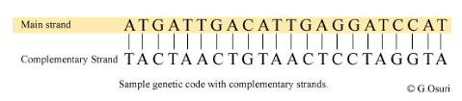
What is a Sequence?
Specific linear order of nucleotides (in DNA or RNA) or amino acids (in proteins) that determines the structure and function of these biomolecules.
DNA Sequence: The arrangement of bases (adeniine [A], thymine [T] cytosine [C], guanine [G]).
RNA Sequence: The arrangement of bases (adenine [A], uracil [U], cytosine [C], guanine [G]).
Protein Sequence: The arrangement of amino acids in a polypeptide chain.
Sequences encode genetic information and are fundamental to biological processes like replication, transcription, and translation.

Slide 5
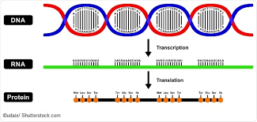
Examples of Sequences?
DNA Sequence: order of nucleotide bases (adenine, thymine, cytosine, guanine)
Example. ATCGTACGGA
RNA Sequence: Similar to, DNA1 but thymine (T) is replaced by uracil (U) 'in RNA.
Example: AUCGAUCGGA
Protein Sequence: order ,of amino acids (e.g., methionine, alanine, leucine,,glycine)
Example· MET-ALA-LEU-GLV

Slide 6
FASTA
A text-based file format used to represent nucleotide or protein sequences. It is commonly used in bioinformatics to store and exchange sequence data. A FASTA file consists of:
1. Header Line: Starts with a > symbol, followed by an identifier or description of the sequence.
2. Sequence Data: The following lines contain the actual sequence, either nucleotide (DNA/ RNA)
or protein, and can span multiple lines.
Example:
>Sequence_ID_1 Description of the first sequence AGCTAGCTAGCTAGCTAGCTAGCTAGCTAGCTA
>Sequence_lD_2 Description of the second sequence TGCATGCATGCATGCATGCGTACGATCGTACG

Slide 7
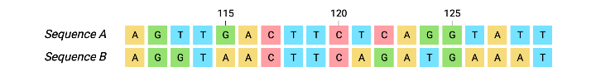
What is Sequence Alignment?
Sequence alignment is the process of arranging two or more biological sequences such as nucleotide (DNA, RNA), or amino acid (protein) sequences to identify regions of similarity.

Slide 8
What alignments can help?
Determine evolutionary relationships among genes, proteins, and species
Determine function of a newly discovered gene sequence
Predicting structure and function of protein

Slide 9
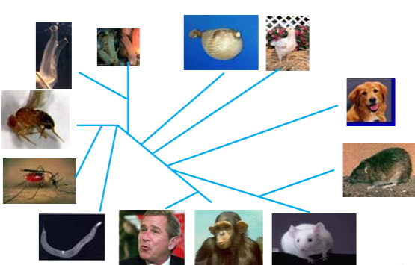
lmportance of Sequence Alignment in
Bioinformatics
Evolutionary Relationships
Helps in identifying similarities between genes/
proteins from different species.
Homologous sequences,(genes from a common ancestor) can be identified through alignment.
Helps inferring evolutionary distances using substitution patterns (changes in nucleotides).
Helps in phylogenetic tree construction

Slide 10
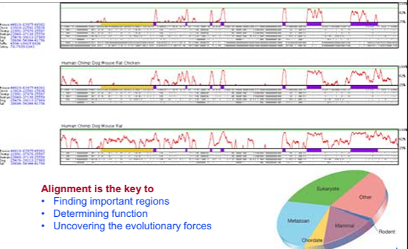
Sequence conversation implies function

Slide 11
Algorithm used in Dynamic programming
Needleman-wunsch Algorithm
Smith-Waterman algorithm
Developed by Saul.b. needleman & christian.d. wunsch
Developed by Temple.F.Smith & Michael. S. Waterman
Referred as global alignment
Referred as local alignment
Used in aligning 2 closely related sequence
Used in aligning divergent sequences
Compares the whole sequence
Compares a patch from the sequence
Tools:- EMBOSS-Needle, Specialised BLAST
Tools:-EMBOSS-Water, LALIGN

Slide 12
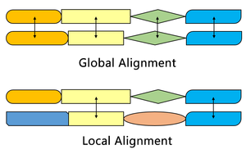
Comparison of Global and Local alignment in general

Slide 13
Needleman-Wunsch algorithm
Aligns protein or nucleic acid sequences
Divides a large problem into a series of smaller problems
Uses the solution of smaller problem to reconstruct a solution to the larger problems

Slide 14
Constructing the matrix
We will have 2 matrices of 2D representation viz,
The score matrix
Traceback matrix
The N-W algorithm consists of 4 steps:-
Initialization of the score matrix
Filling up the matrix
Traceback
Alignment

Slide 15
1. Initializing the scoring matrix
 |  | G | C | A | T | G | C
 | 0 | -1 | -2 | -3 | -4 | -5 | -6
G | -1
T | -2
A | -3
C | -4
G | -5
C | -6
Match = 1
Mismatch. = -1
Gap. = -1

Slide 16
2. Filling the matrix
 |  | G
 | 0 | -1
G | -1 | X
For x :
This cell has 3 possible values
Top :- (-1)+(-1) = -2
Left :- (-1)+(-1) = -2
Top-left :- (0)+(1) = 1
The highest value is 1 and thus it is entered into the cell
i.e x = 1
 |  | G
 | 0 | -1
G | -1 | 1

Slide 17
Contd..
 |  | G | C
 | 0 | -1 | -2
G | -1 | 1 | X
C | -2 | Y
For X :
Top: (-2)+(-1) = (-3)
Left: (+1)+(-1) = (0)
Top-Left: (-1)+(-1) = (-2)
For Y :
Top: (1)+(-1) = (0)
Left: (-2)+(-1) = (-3)
Top-Left: (-1)+(-1) = (-2)
The highest value for X and Y is 0, thus it is entered into the cell.
i.e X = O; Y = 0
 |  | G | C
 | 0 | -1 | -2
G | -1 | 1 | 0
C | -2 | 0

Slide 18
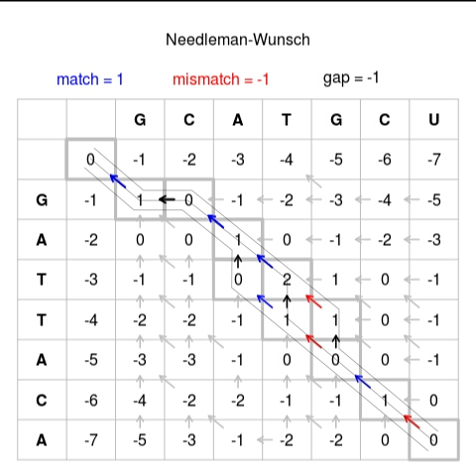
3. Traceback

Slide 19

4. Alignment
Rules :-
If arrow is vertical/horizontal assign a gap and a character
:- Gaps and characters
Where to Assign
a gap and a character ?
Sequence 1 or 2

Slide 20
Contd…
Ans) The gap will be assigned in the direction of the arrow and the character will be assigned in the opposite direction
2. If there is a diagonal arrow both the characters will be assigned
:- Both characters

Slide 21
Result of alignment
G C T A G C -
. .
G - T A C G C

Slide 22
Smith-Waterman algorithm
S-W algorithm is modified version of Needleman- Wunsch algorithm
Negative scoring matrix cells are set to zero
Traceback procedure starts at the highest scoring matrix cells and procedure until a cell with score zero is found

Slide 23
Constructing the matrix
 |  | G | C | A | T | G | C
 | 0 | 0 | 0 | 0 | 0 | 0 | 0
G | 0
C | 0
A | 0
T | 0
G | 0
C | 0
Match = 1
Mismatch. = -1
Gap. = -1

Slide 24
Contd..
 |  | G | C
 | 0 | -1 | -2
G | -1 | 1 | X
C | -2 | Y
For X :
Top: (-2)+(-1) = (-3)
Left: (+1)+(-1) = (0)
Top-Left: (-1)+(-1) = (-2)
For Y :
Top: (1)+(-1) = (0)
Left: (-2)+(-1) = (-3)
Top-Left: (-1)+(-1) = (-2)
The highest value for X and Y is 0, thus it is entered into the cell.
i.e X = O; Y = 0
 |  | G | C
 | 0 | -1 | -2
G | -1 | 1 | 0
C | -2 | 0

Slide 25
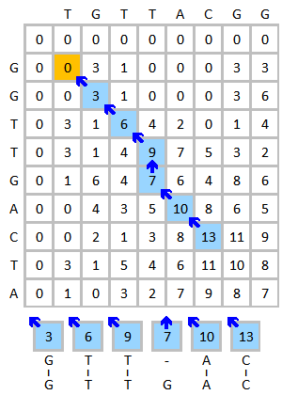
Traceback

Slide 26
Alignment
Rules:
Same as of Needleman- Wunsch algorithm

Slide 27
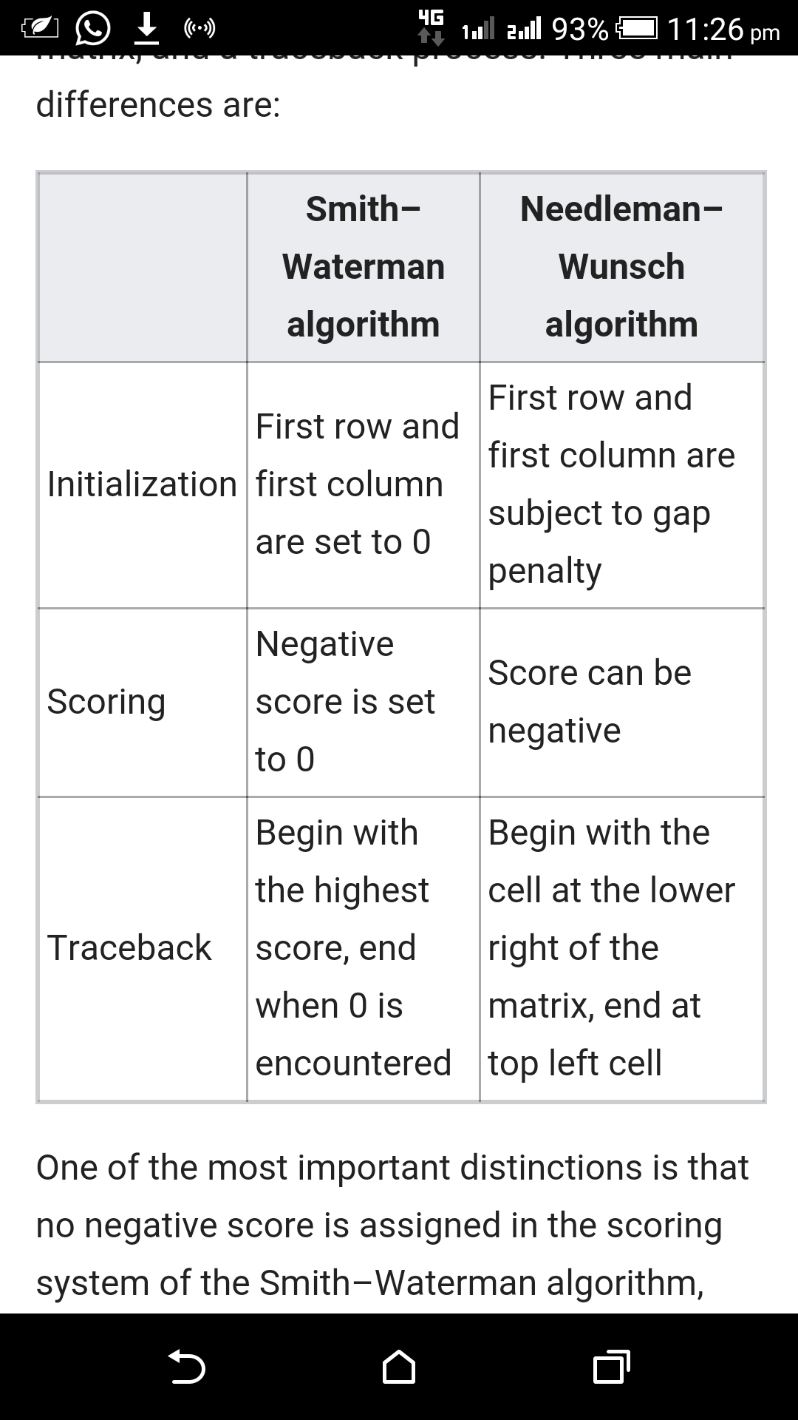
Difference between the procedure of S-W and N-W algorithm

Slide 28
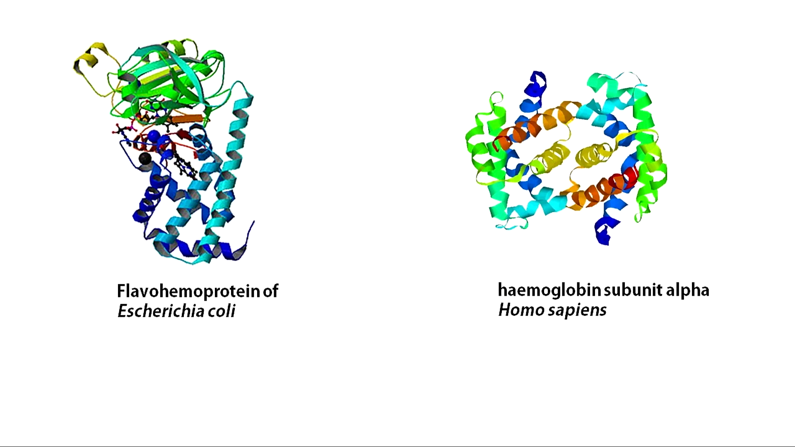
Example

Slide 29
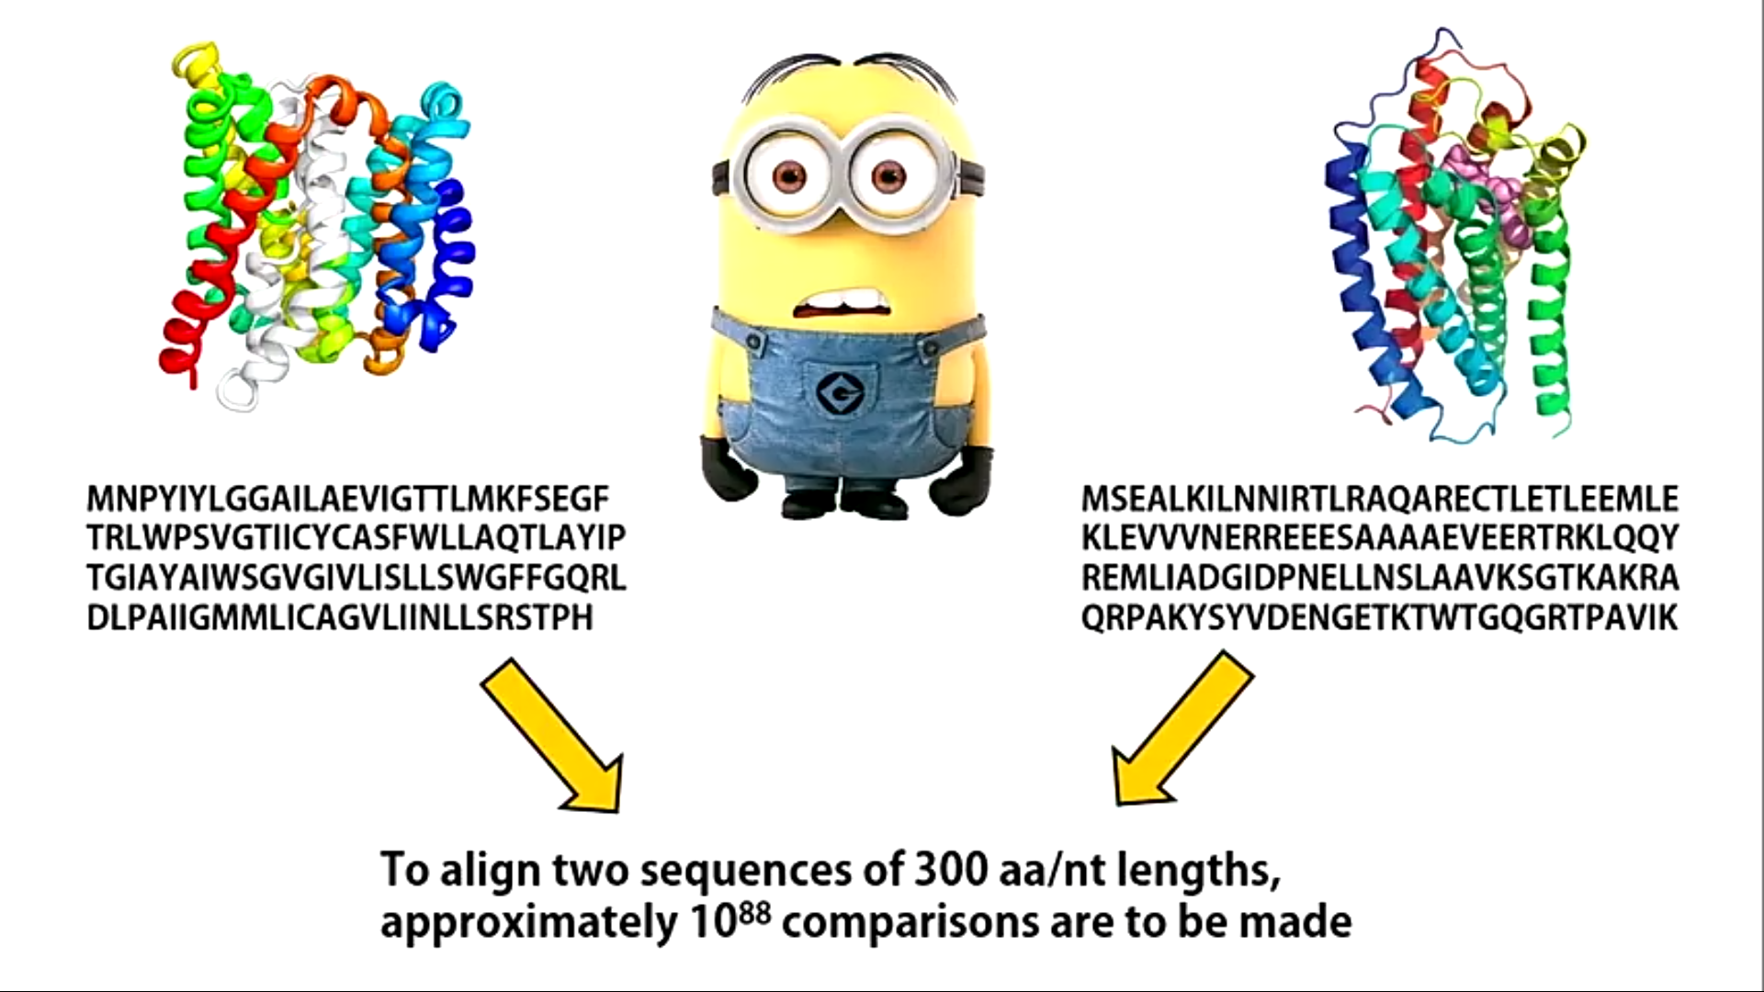

Slide 30
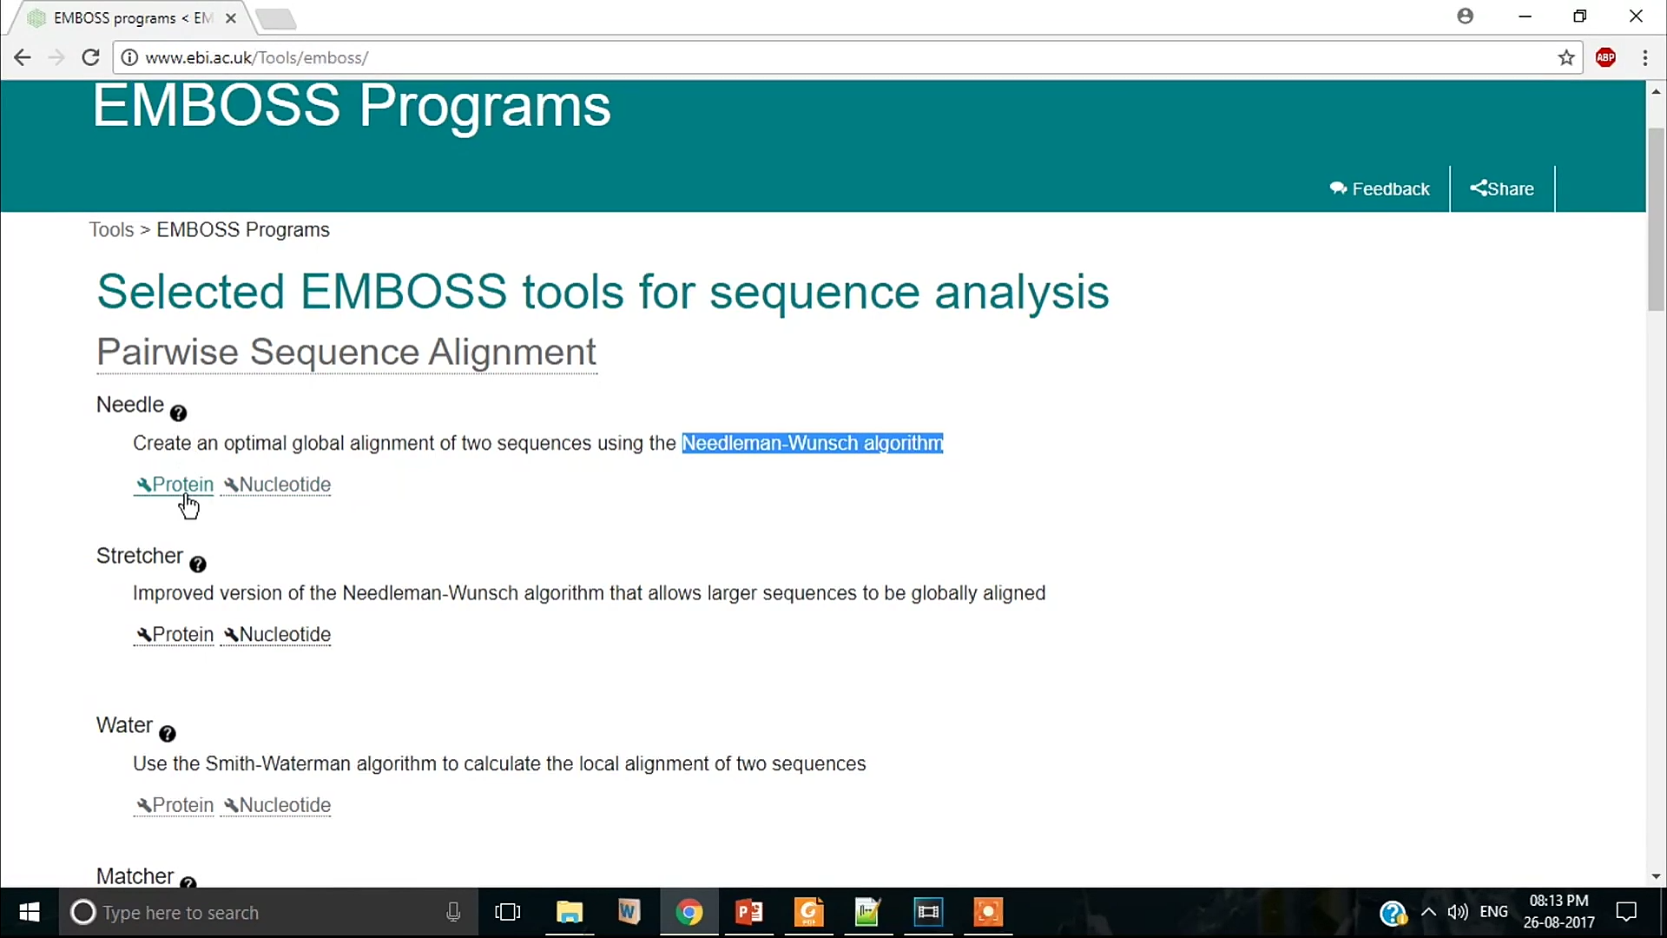
Emboss homepage

Slide 31
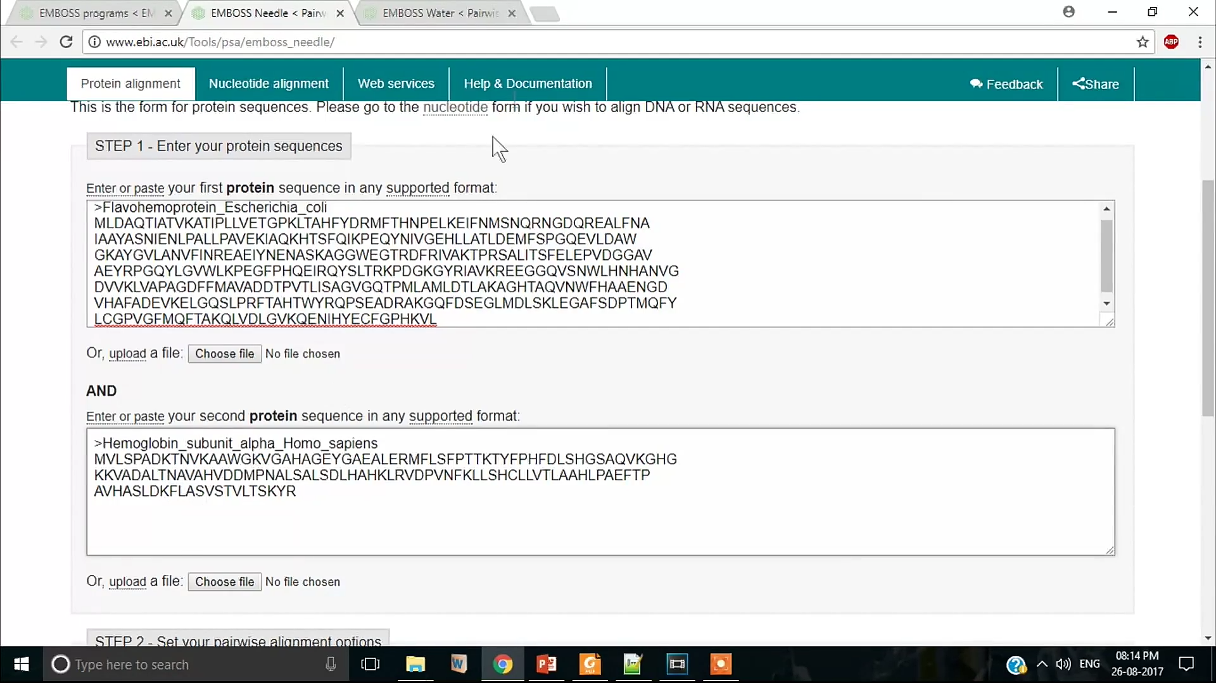
Entering the sequence to be compared in N-W algorithm

Slide 32
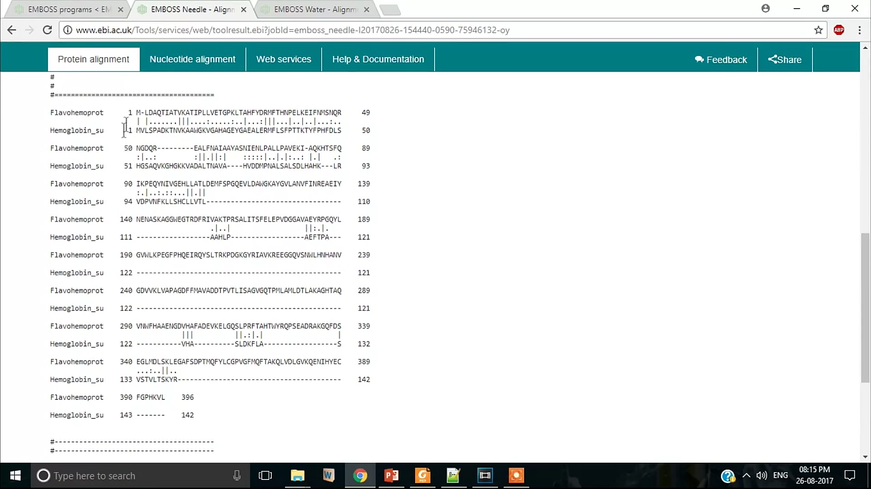
Protein alignment result

Slide 33
Pairwise sequence alignment
When comparing 2 sequences it is Pairwise sequence alignment (nucleic acids or protein)
When comparing more than 2 sequence it is Mulitiple sequence alignment (nucleic acids or protein)

Slide 34
Contd…
Pairwise sequence alignment is concerned with comparing 2 DNA or 2 Amino acids sequences
For ex.
BLASTn :- for nucleotide sequence
BLASTp :- for protein sequence

Slide 35
BLAST-n and BLAST-P
BLAST is a Basic Local Alignment Search Tool.
Used for comparing primary biological information viz,
Amino acid sequences of protein
Nucleotide of DNA or RNA sequences
BLASTn and BLASTp is particularly used for comparing nucleotide sequence and protein sequence respectively

Slide 36
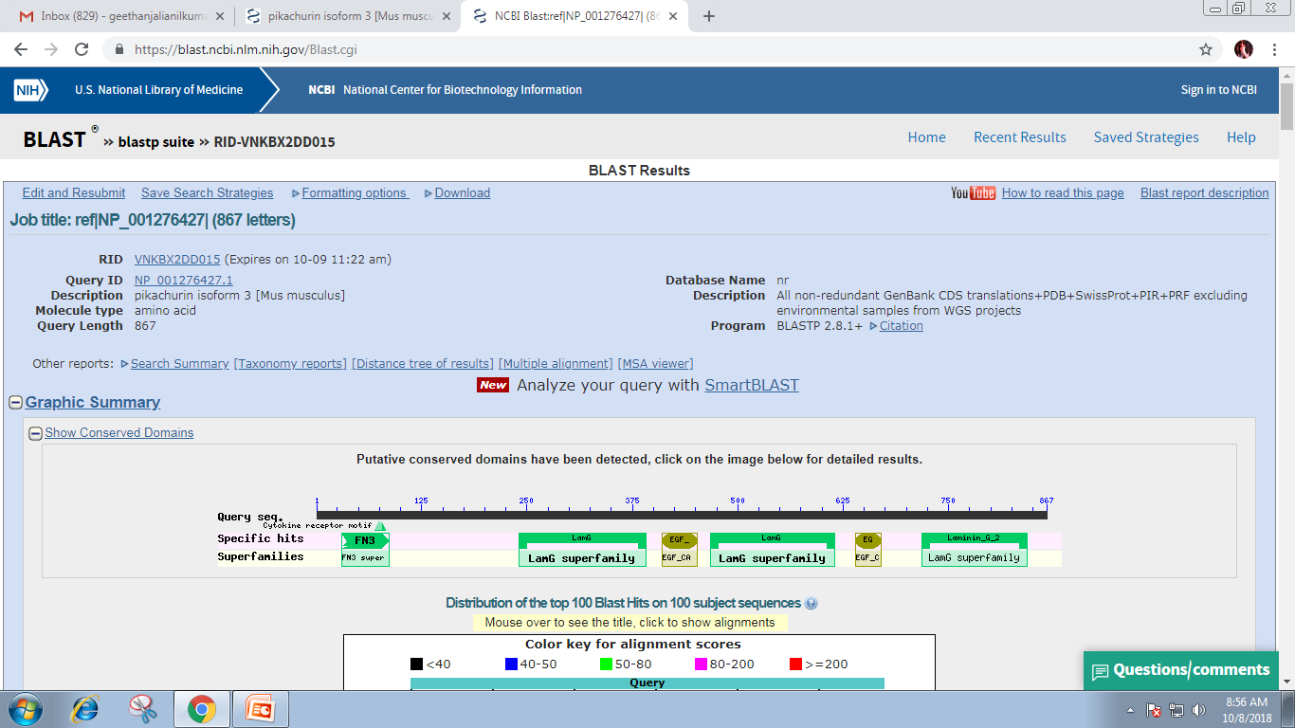
Result of Paralichthys olivaceus in BLASTn

Slide 37
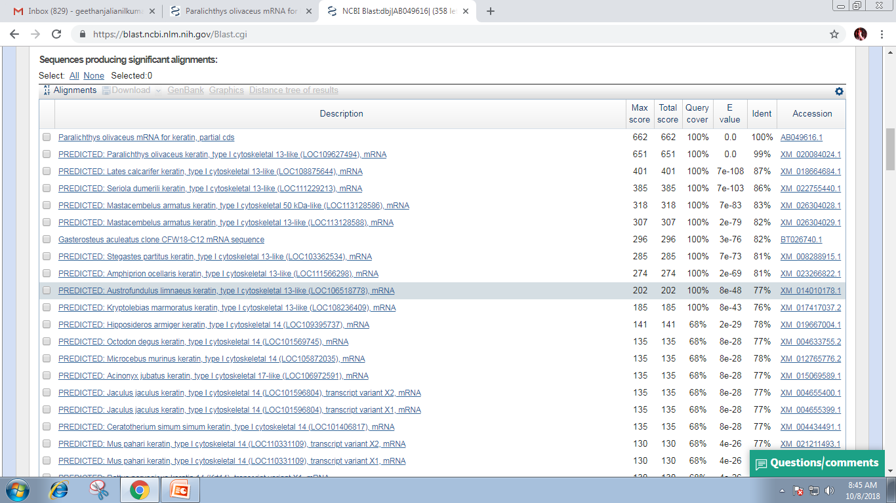
Sequence producing significant alignment

Slide 38
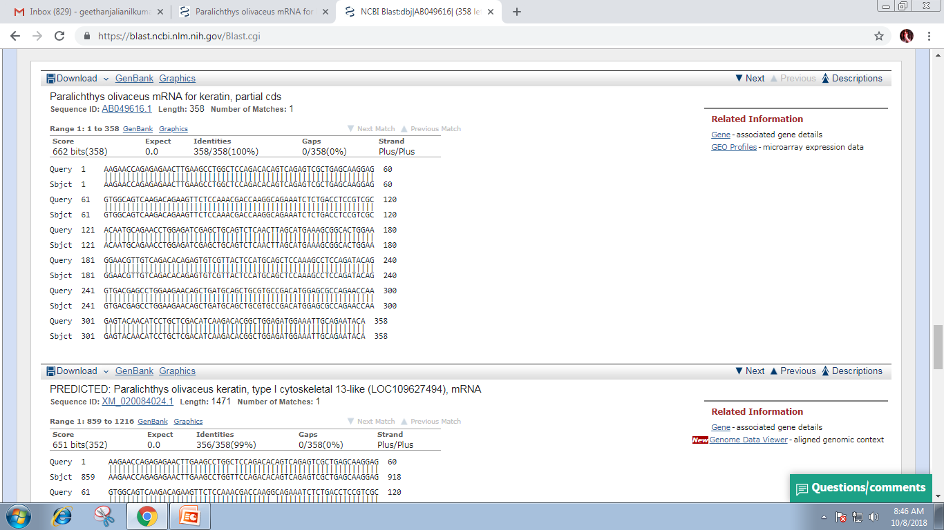
Sequence alignment of Paralichthys olivaceus

Slide 39
Applications of pairwise sequence alignment
Searching large sequences for matches
Characterize newly sequenced genes or gene products
Molecular distance of evolution between species

Slide 40
Lunch Break

Slide 41
Day 2: Sequence Alignment and Phylogenetic Afternoon Session

Slide 42
Outline Day 2
Afternoon (2-5 pm): Phylogentics
Phylogentics:
Introduction to Phylogentics tree concept, and significance in evolution biology.
Practical Session:
Construct phylogentics trees using Clustal Omega (web-based) starting from multiple sequence alignments.
Code with python

Slide 43
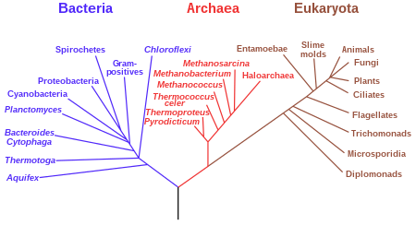
Phylogenetic tree

Slide 44
A phylogenetic tree is a diagram that represents evolutionary relationships among organisms based on the similarities and differences in their genetic and evolutionary characteristics
The pattern of branching in a phylogenetic tree reflects how species or other groups evolved from a series of common ancestors.
The phylogenetic tree is also called the “Tree of Life” or “Dendrogram”

Slide 45
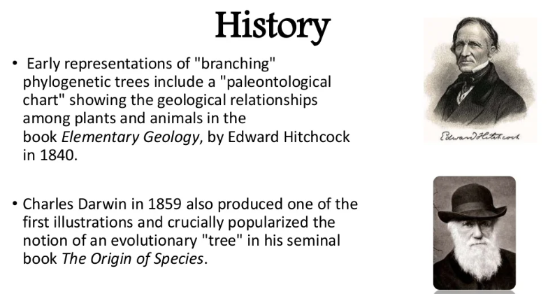

Slide 46
Importance of Phylogenetic Tree
It is the fundamental tool to derive their most-useful evidence from the fields of anatomy, embryology, palaeontology and molecular genetics. Other significances of the phylogenetic tree are:
Used in the search for a new species.
Used to study evolutionary histories.
To study how the species were spread geographically.
To study the common ancestors of extant and extinct species.
It is used to identify the most recent common ancestors and to recognize how closely related species are.
To relate the milestones of the evolution of major life forms to the tree of life.
To represent evolutionary relationships between organisms that are believed to have some common ancestry.
With the help of the phylogenetic tree, the infectious microbes can be traced along with their evolutionary histories.

Slide 47
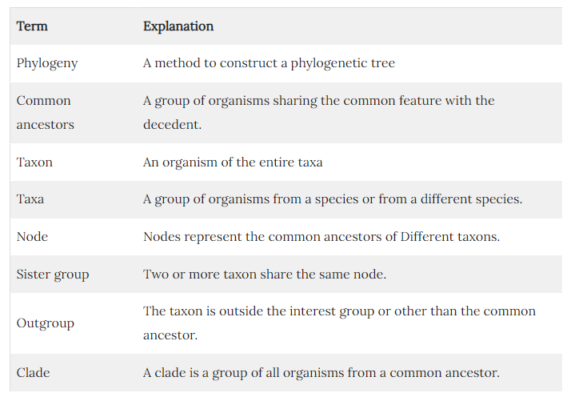

Slide 48
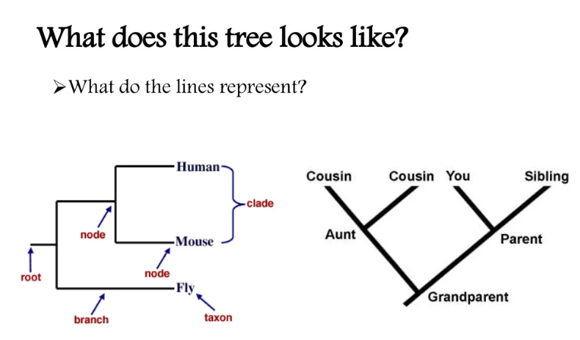

Slide 49
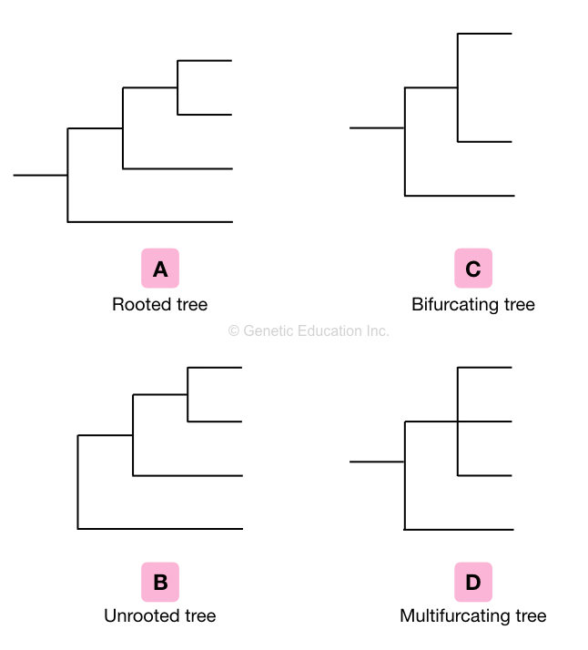

Slide 50
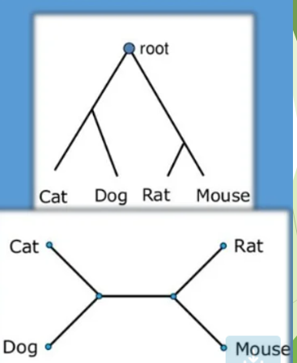
Rooted tree:
The rooted tree is described as a phylogenetic tree sharing the common ancestor on the node. Therefore the classification ends at one point usually on the node which is the common ancestor of all the branches of the tree.
Unrooted tree:
Contrary to the rooted tree, the non-rooted tree doesn’t have a common ancestor. The unrooted phylogenetic tree is always prepared from the rooted tree by excluding the common ancestor or the node of the tree.

Slide 51
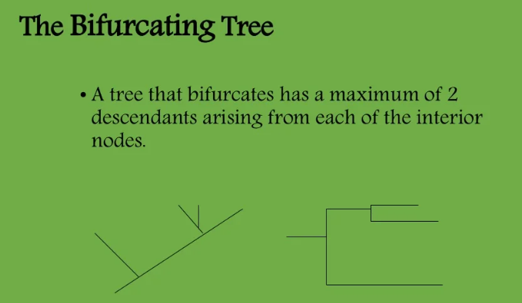
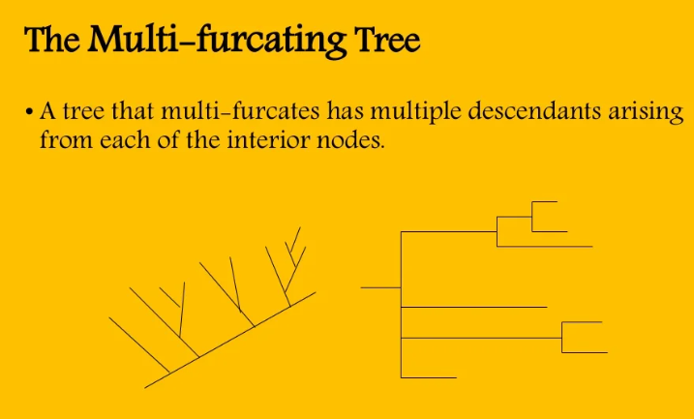
Bifurcating tree
The phylogenetic tree only has two branches or we can say leaves are known as bifurcating trees. It is also classified in rooted bifurcation trees and unrooted bifurcating trees.
Multifurcating tree:
The multifurcating tree is described as having multiple branches on a single node. Again, it is classified into a rooted multifurcating tree and an unrooted multifurcating tree.

Slide 52
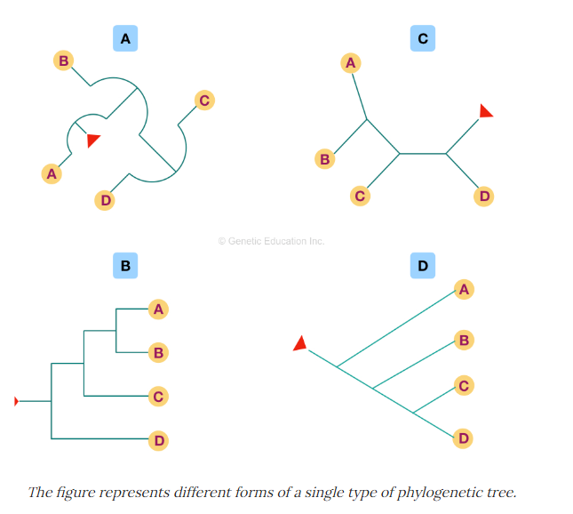
In phylogeny, the node is also known as a “clade” as well. Though there are so many different variations of the phylogenetic tree, every method of making a tree depicts the same type of information. Take a look at various trees shown in the figure Keep in mind that whatever the shape, topology or structure of the tree is, it must have a common node if rooted and branched. To read a tree, start with the tip of the branches and see where the branch ends (the node), based on that information you can depict or conclude which organism is nearer or closer and which are distantly related.

Slide 53
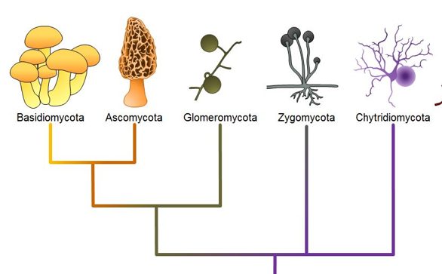
Phylogeny in fungus

Slide 54
Applications of a phylogenetic tree:
The phylogenetic tree is constructed to make an evolutionary link between various organisms. By doing so, we can get an idea about how and from whom different organisms are evolved.
Also, it helps to classify organisms and species in different taxa and groups based on their DNA sequence and phenotypic similarities and differences.
In addition to this, it is useful to study the force of evolution and characteristics of different organisms.
it is applicable to study the events occurring during the course of evolution and to classify species based on the divergence of structure and function.

Slide 55
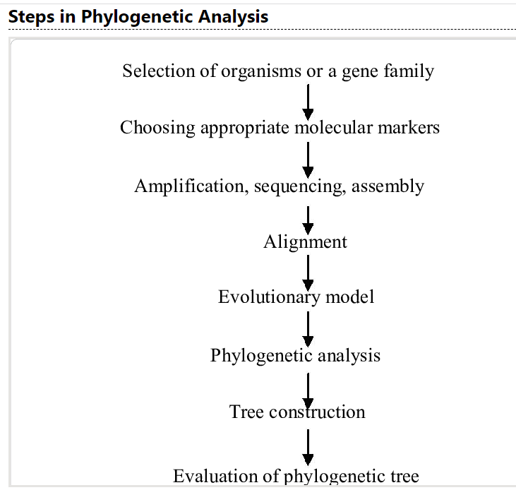

Slide 56
Software
Some programs for phylogenetic analysis
A multiple alignment program:
Clustal, T-Coffee, MAFFT, Muscle…
A phylogenetic program:
Phylip, PAUP*, MacClade, BioEdit…
Visualizing the tree:
TreeView, Njplot
https://evolution.genetics.washington.edu/phylip/software.html

Slide 57
Selecting sequence
The rate of mutation is assumed to be the same in both coding and non-coding region
However there is a difference in substitution rate
Non-coding DNA region have more substituion than coding regions.
Protien are much more conserved since they need to conseve their function
It is better to use sequence that mutate slowly (protein) than DNA. If the gene are very small or they mutate slowly, then it cam use for building tree.

Slide 58
Building Phylogenetic Trees
The most popular and frequently used methods of tree building can be classified into two major categories
Phenetic methods based on distances
Cladistic methods based on characters
Distance matrix methods
UPGMA (Unweighted pair group methods with arithmetic mean)
Fitech-Margoliash
Neighbour joining (NJ)
Character based methods
Maximum parsimony (MP)
Maximum likelihood (ML)

Slide 59
Distance based methods
Tree are calculated by similiarities of sequences and are based on distance
Some sequences more similar than others
Closely related sequences should be close in the tree
Only use the distances between sequences
All methods start with a distance matrix

Slide 60
UPGMA Vs Fitch Margoliash Method
UPGMA Methods
Unweighted Pair Group Method with Arithmetic Mean
Unweighted: The distances are used as they are
Pair: Find the two closest elements
Group: Put them together in a new group
Arithmetic Mean: Gives distances from the new group
Fitch-Margoliash Methods
More complicated than UPGMA
Does not assume a molecular clock
Produces an unrooted scaled tree

Slide 61
Neighbour joining
This methods tries to correct the UPGMA method for its assumption that the rate of evolutions is the same in all taxa.
But it assumes an additive tree
Distance between two leaves is the sum of the edges
Find the closest pair that is most apart from the rest of the tree
Connect pair and update distances
A little advanced: Take the overall distance to the rest of the tree into account
Corrects for varying mutation
Fast and can give good results

Slide 62
Character methods
Tree are calculated by considering the various possible pathways of evolution.
This methods uses each alignment positions as evolutionary information to build a tree.
All information at hand
More advanced, slower, but also more accurate
Maximum Parsimony (MP)
Occam’s razor: Simplest explanation
Maximum Likelihood (ML)
Advanced statistical method
Most probable tree given the data and the model

Slide 63
Maximum parsimony (MP)
For each positon in the alignemnt all possible trees are evaluated and are given a score based on the number of evooution changes.
More time consuming
Used for closely related sequences
The most parsimonious tree is the one with the fewest evolutionary changes
MP methods are available for DNA in Programs paup, molphy, phylo_win

Slide 64
Maximum Likelihood
This methods also uses each position in an alignment, evaluate all possible trees and calcultes the likelihood for each tree.
The tree with the maximum likelihood is the most probable tree.
Slowest methods but gives the best result
Used for any set of sequence.
Maximum likelikhood methods can found in phylip, paup or puzzle

